Slide 1

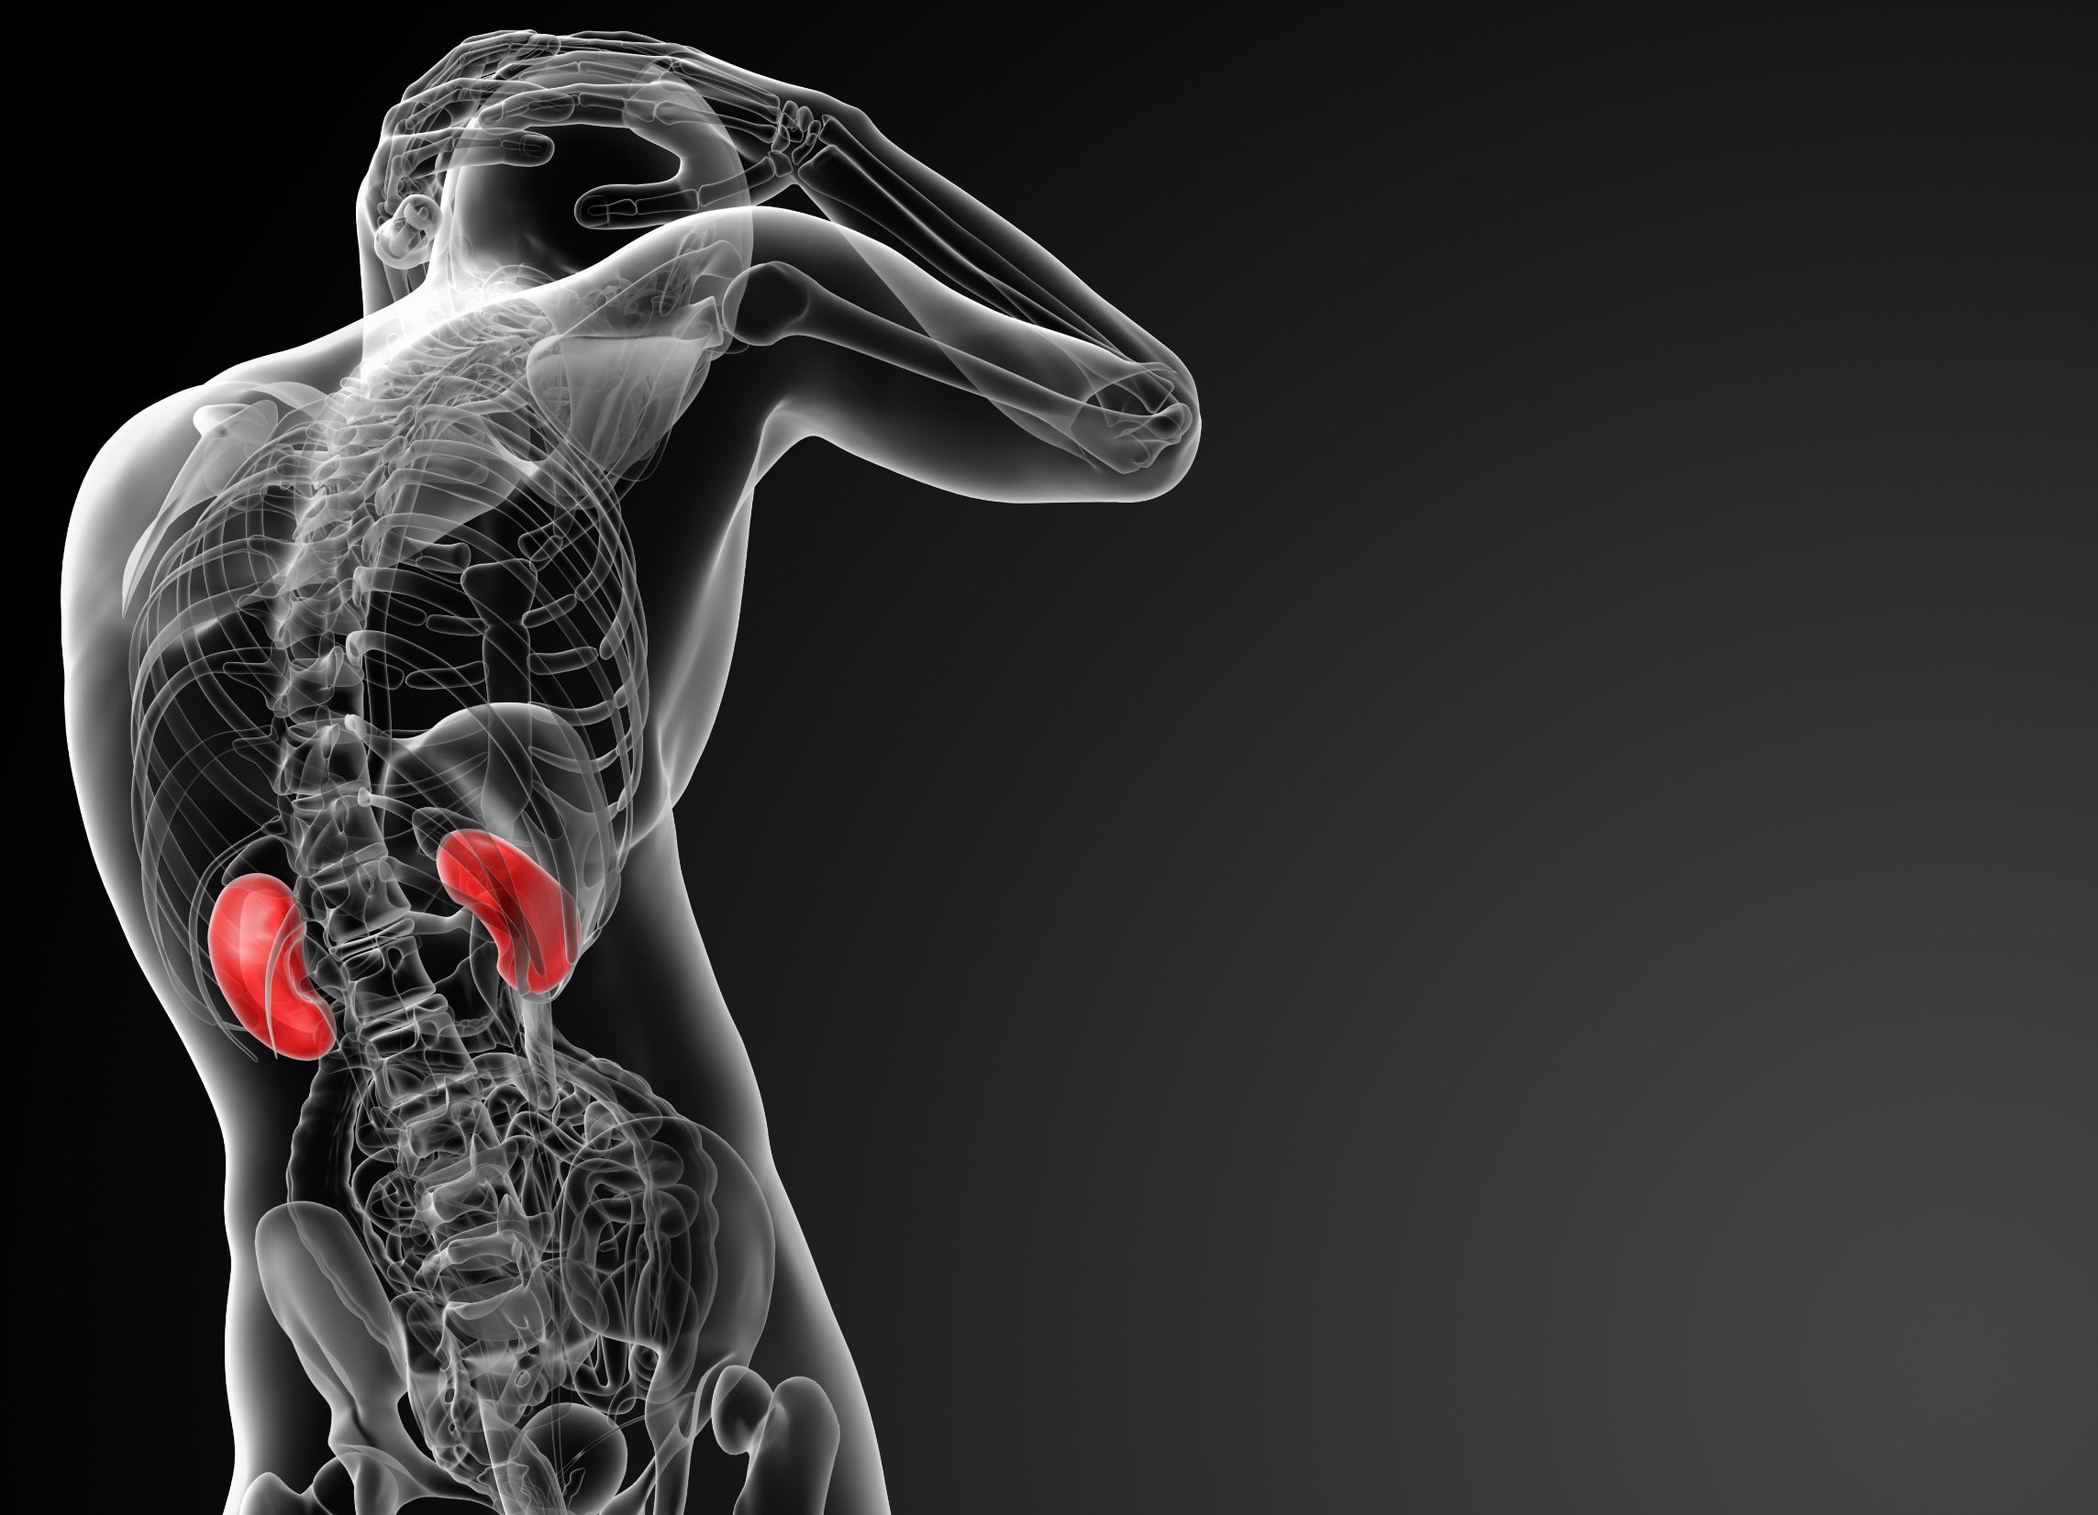
6 cm
11 cm
In adults a kidney is about 10 cm long, 6 cm broad and 4 cm thick—about the size of your fist. It weighs approximately 150-170 grams (5.2 – 5.9 Oz).

Slide 2
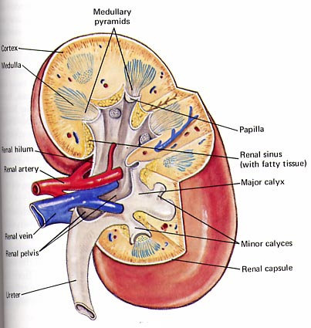
Structure of kidney
Cortex
Glomeruli
Medulla
Renal tubules
(with calyces forming the medulary pyramids)
Ureter
Takes urine to bladder
Blood carried to the kidney by the renal artery and taken away by the renal vein.

Slide 3
Structure of nephron : (Filtration Unit)
Nephron is the functional unit of the kidney,
the structure that actually produces urine in the process of removing waste and excess substances from the blood
1 millions nephrons in each human kidney.
Each nephron is a long tubule, about 30–55 mm (1.2–2.2 inches) long.
At one end this tube is closed, expanded, and folded into a double-walled cuplike structure.
This structure, called the bowman capsule . It encloses a cluster of microscopic blood vessels known as capillaries—called the glomerulus.

Slide 4
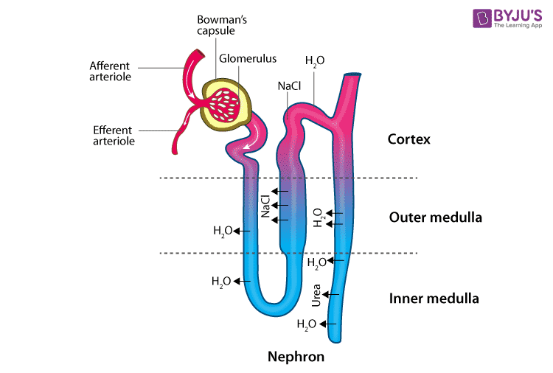
Nephron structure : Key filtration Unit

Slide 5
Mechanism of Ultrafilration
Nephron contains glomerules and long renal tubules
Glomerulus filtered excess of water , remove toxic waste from the blood through semipermeable membrane.
Filtrate then enters long renal tubule , upper portion of tubule is known as proximal convolutional tubule (PCT), it involves in reabsorption of electrolytes amino acids etc back in to the blood.
Finally the blood emerges from the kidney is free from toxic and balanced volume of the water.

Slide 6
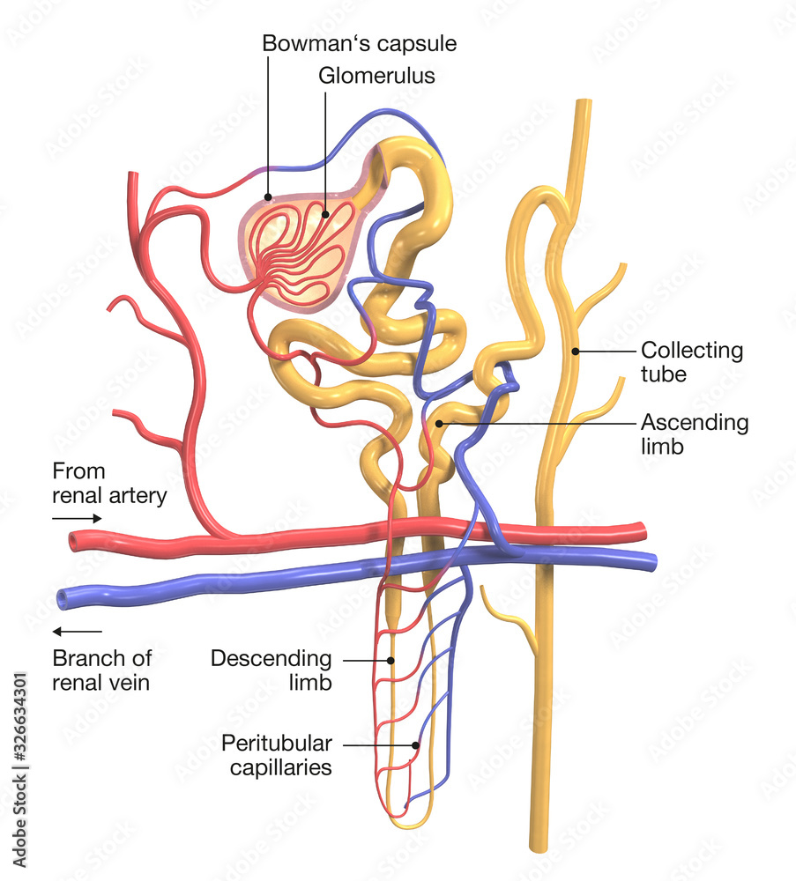

Slide 7
Functions of Kidney
Remove waste products from the body.
Remove drugs from the body.
Balance the body's fluids.
Release hormones that regulate blood pressure.
Produce an active form of vitamin D that promotes strong, healthy bones.
Control the production of red blood cells. ( RBC)

Slide 8
Every minute
In one day
1200 ml of blood enters both kidneys
1700 liters of blood is purified
20% of the total blood pumped by the heart
3592.7 pints
Did you know that every minute 1200 ml (40.6 Oz) of blood enters in both kidneys for purification, which is 20% of the total blood pumped by the heart? So in one day 1700 liters (3592.7 pints) of blood is purified!
Notes:
Did you know that every minute 1200 ml (40.6 Oz) of blood enters in both kidneys for purification, which is 20% of the total blood pumped by the heart? So in one day 1700 liters (3592.7 pints) of blood is purified!

Slide 9
Early kidney disease has no signs or symptoms
Some people don't have healthy kidneys, and sometimes their kidneys stop working.
Kidney disease means that the kidneys are damaged and can't filter blood like they should. This damage can cause wastes to build up in the body and other problems that can harm your health.
Early kidney disease has no signs or symptoms.
A person may not feel any different until his or her kidney disease is very advanced. Blood and urine tests are the only way to know if you have kidney disease.
Notes:
Some people don't have healthy kidneys, and sometimes their kidneys stop working.
Kidney disease means that the kidneys are damaged and can't filter blood like they should. This damage can cause wastes to build up in the body and other problems that can harm your health.
Early kidney disease has no signs or symptoms.
A person may not feel any different until his or her kidney disease is very advanced. Blood and urine tests are the only way to know if you have kidney disease.

Slide 10
Chronic Kidney Disease : CKD
Kidney disease is one of the leading cause of death in many developed countries.
Kidney complication may worsen blood pressure, anaemia, and even nerve damage, electrolytes imbalance.
The key reason for CKD are diabetic and high blood pressure, high blood sugar can damage renal blood vessels . nerves.
In addition, glomerulonephritis can cause kidney inflammation and results in damaging of kidney filtration units
The blood and urine test are generally done to find out kidney disease such as creatine level in blood and protein in urine

Slide 11
CKD Cont.
Diabetes or high blood sugar can cause damage to nephrons ( filtration unit).
High blood sugar can increase osmotic pressure in the glomerulus and enhances rate of filtration in turn kidney excrete high amount of sugar in the urine
Similarly, blood pressure can narrow and harden blood vessels in kidney and also increase pressure in the glomerulus of nephron.
High blood pressure can damage nephrons and in turn leads to CKD gradually

Slide 12
Blood and urine tests are the only way to know
There are blood tests to check how well your kidneys are filtering and therefore how well they are doing their job.
A urine test can check for albumin in your urine. Albumin is a protein that passes into the urine in increased amounts when the kidneys are damaged.
Notes:
There are blood tests to check how well your kidneys are filtering and therefore how well they are doing their job.
A urine test can check for albumin in your urine. Albumin is a protein that passes into the urine in increased amounts when the kidneys are damaged.

Slide 13
Kidneys function less than 10% of normal
Kidneys no longer function at all
End stage kidney disease
Dialysis
Trans- plantation
If a person’s kidneys are so severely damaged that they function at less than 10% of normal, he or she has what is called “end stage kidney disease.”
When kidneys no longer function at all, special treatments are needed--dialysis or transplantation.
Notes:
If a person’s kidneys are so severely damaged that they function at less than 10% of normal, he or she has what is called “end stage kidney disease.”
When kidneys no longer function at all, special treatments are needed--dialysis or transplantation.

Slide 14
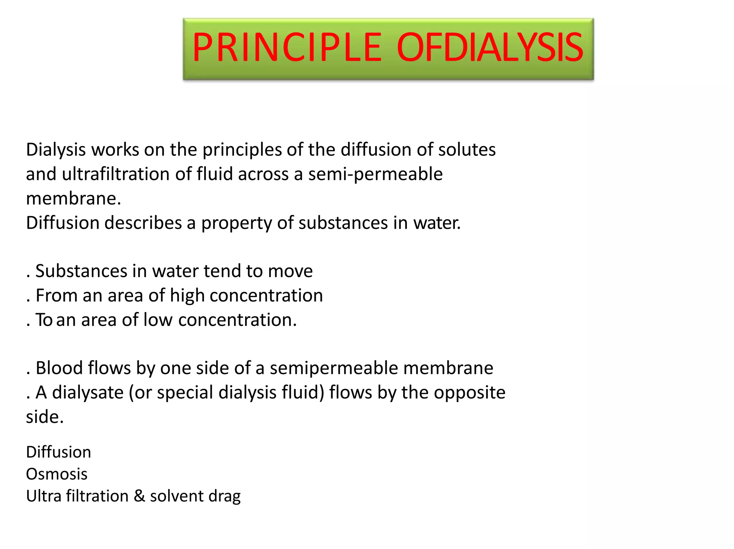

Slide 15
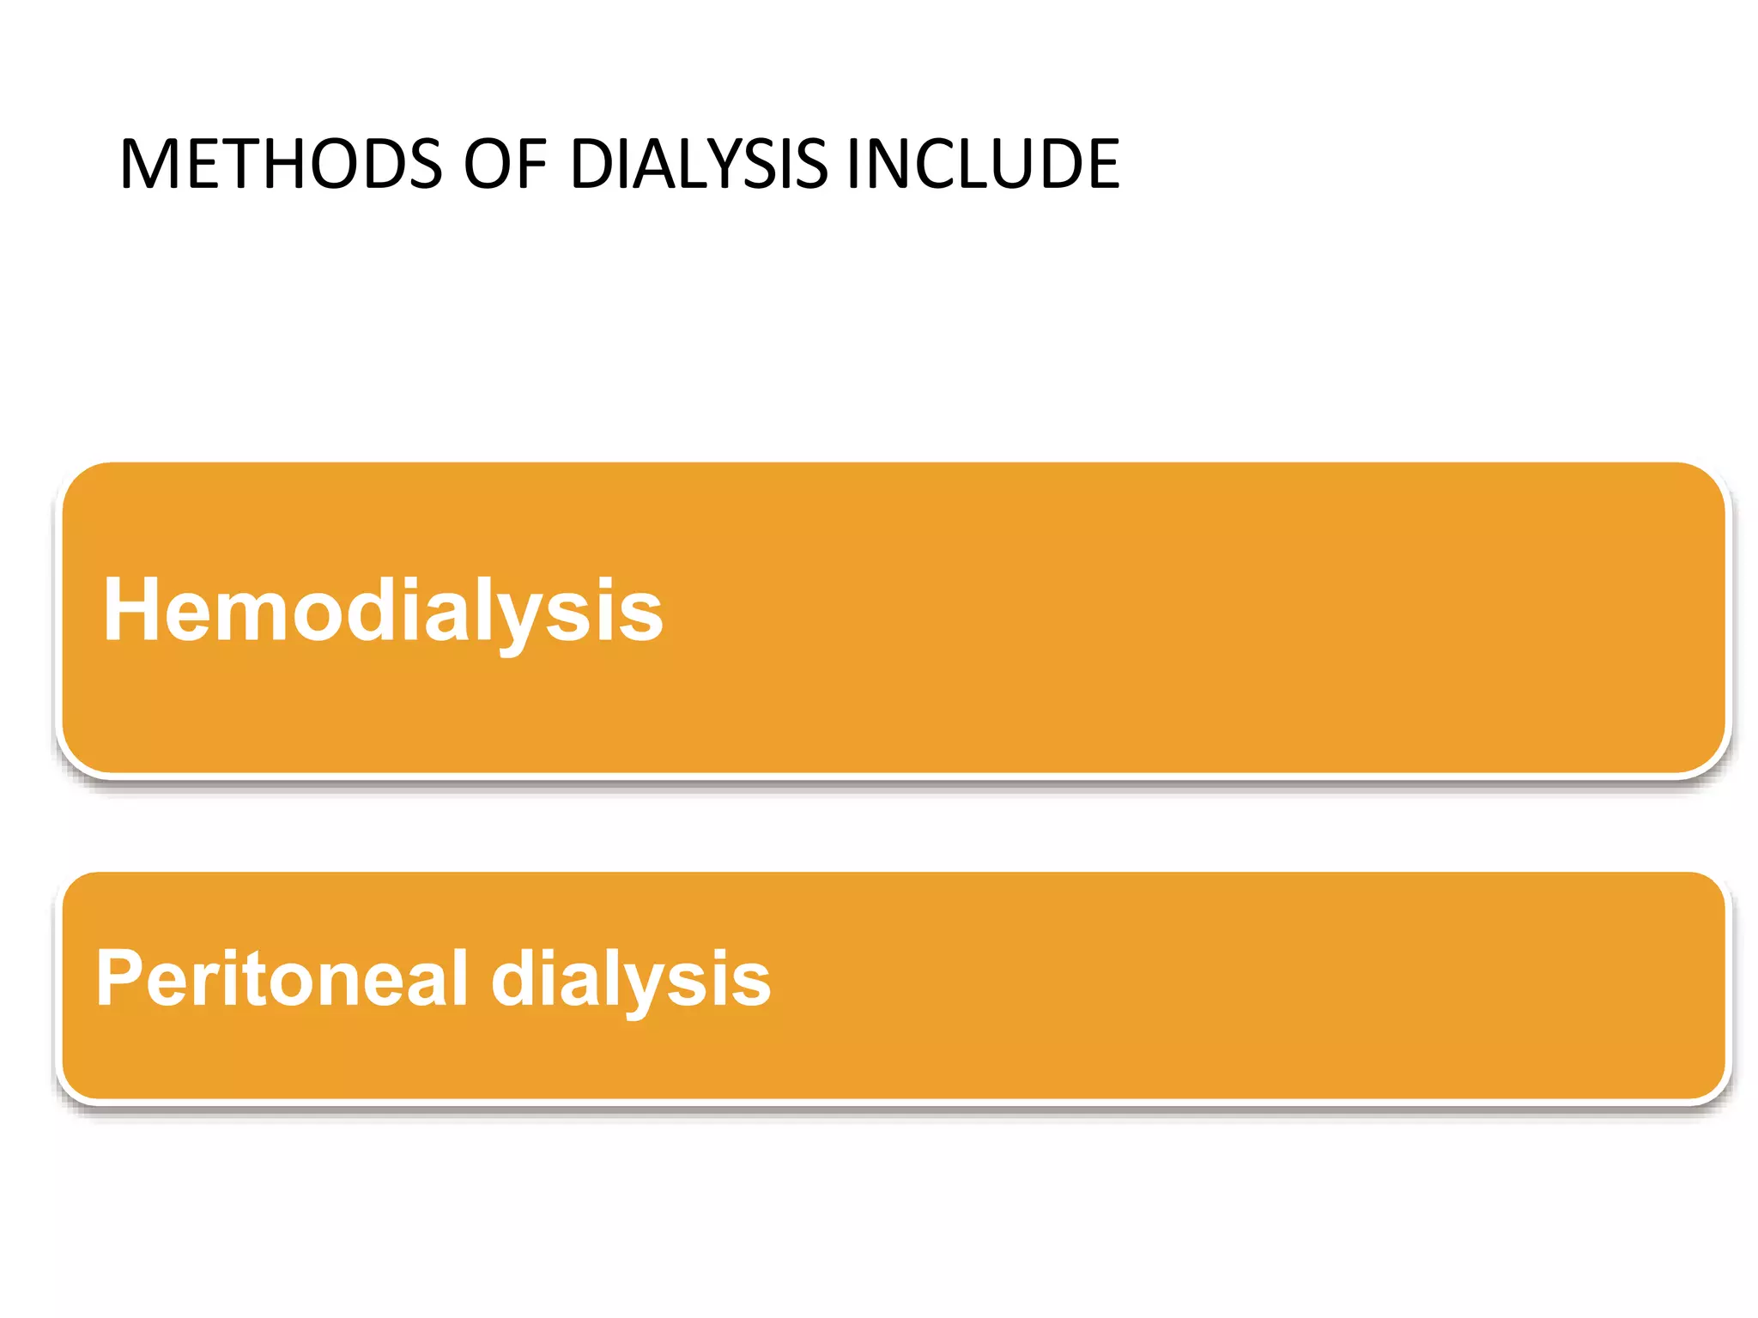
Methods or Types of Dialysis

Slide 16
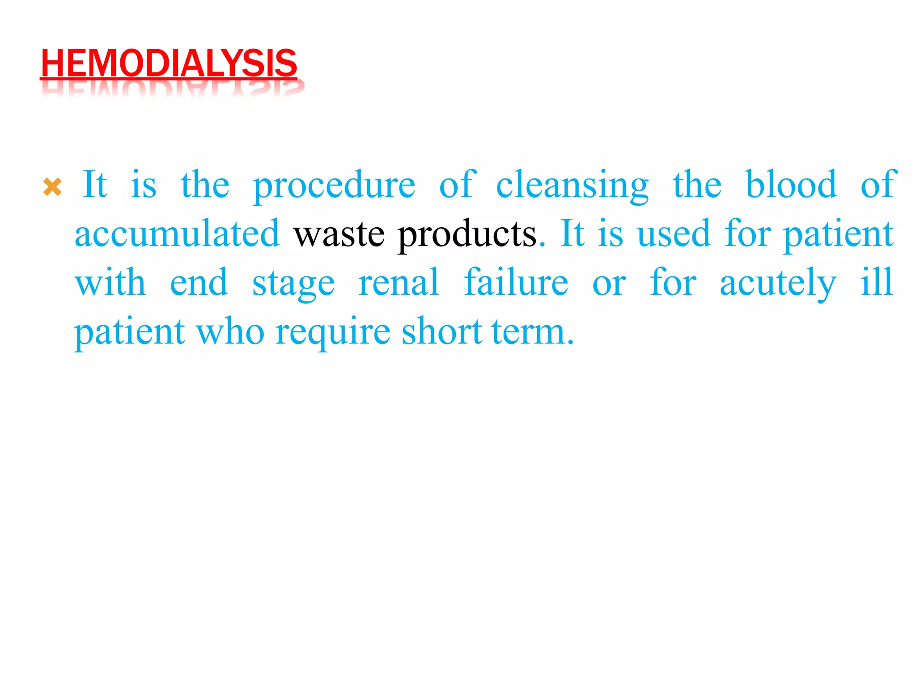

Slide 17
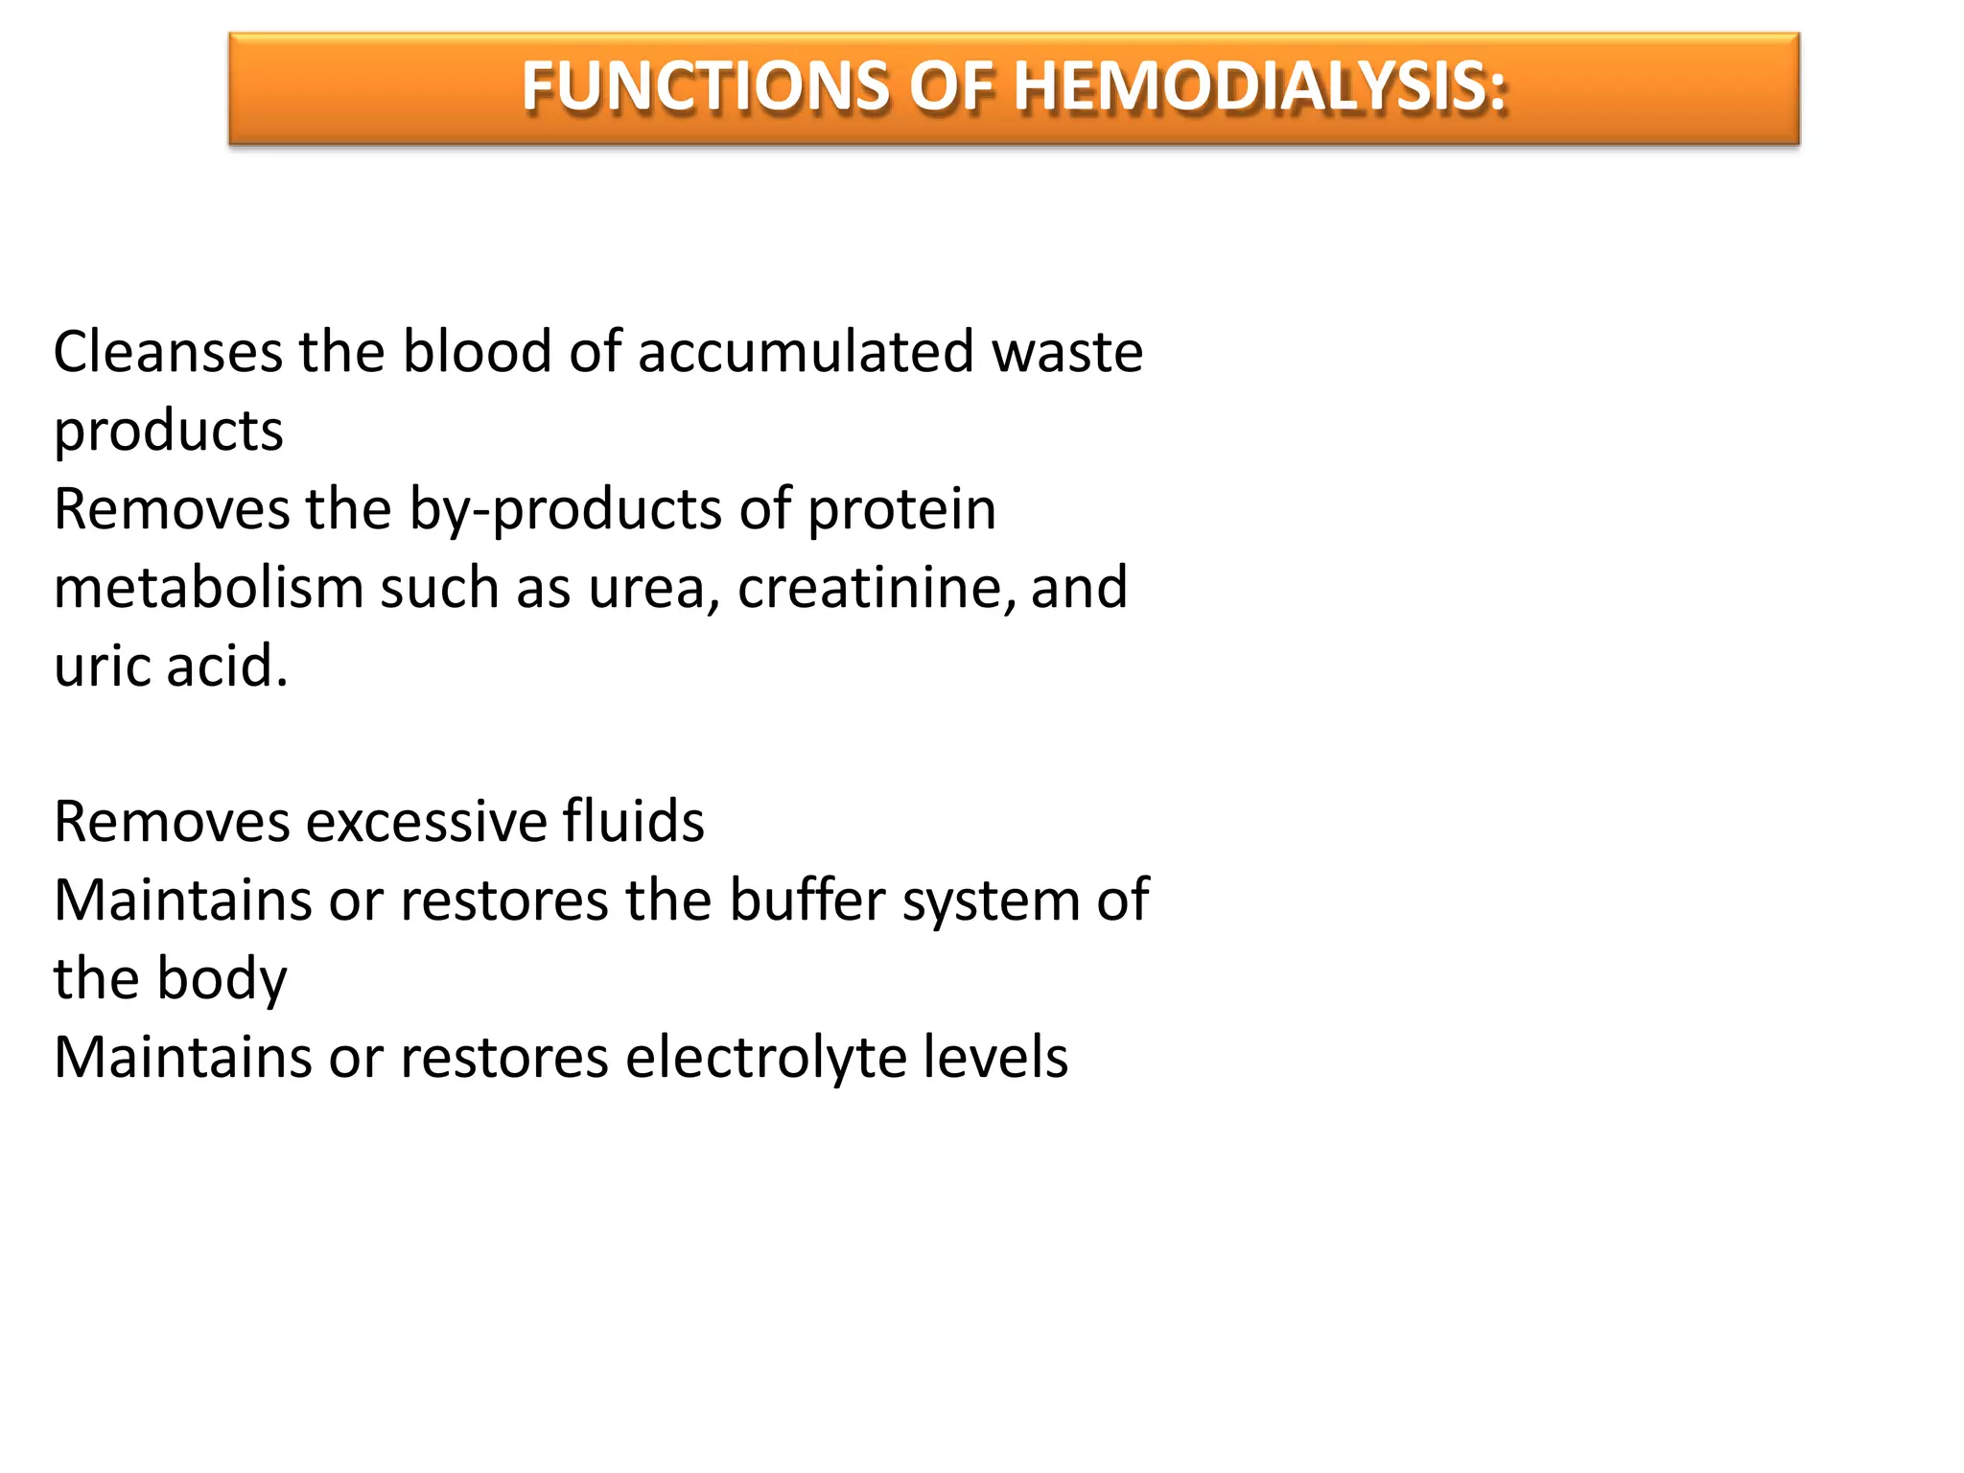

Slide 18
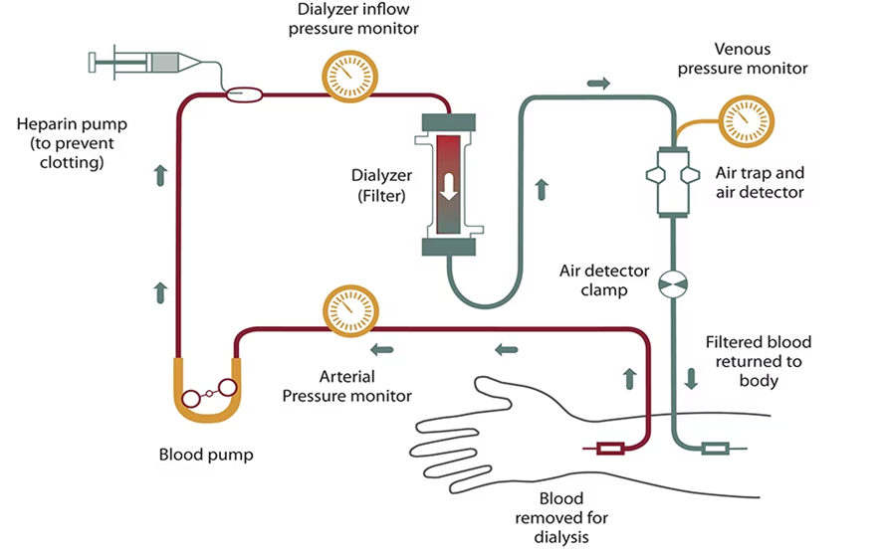
Overview : Haemo-Dialysis Process

Slide 19
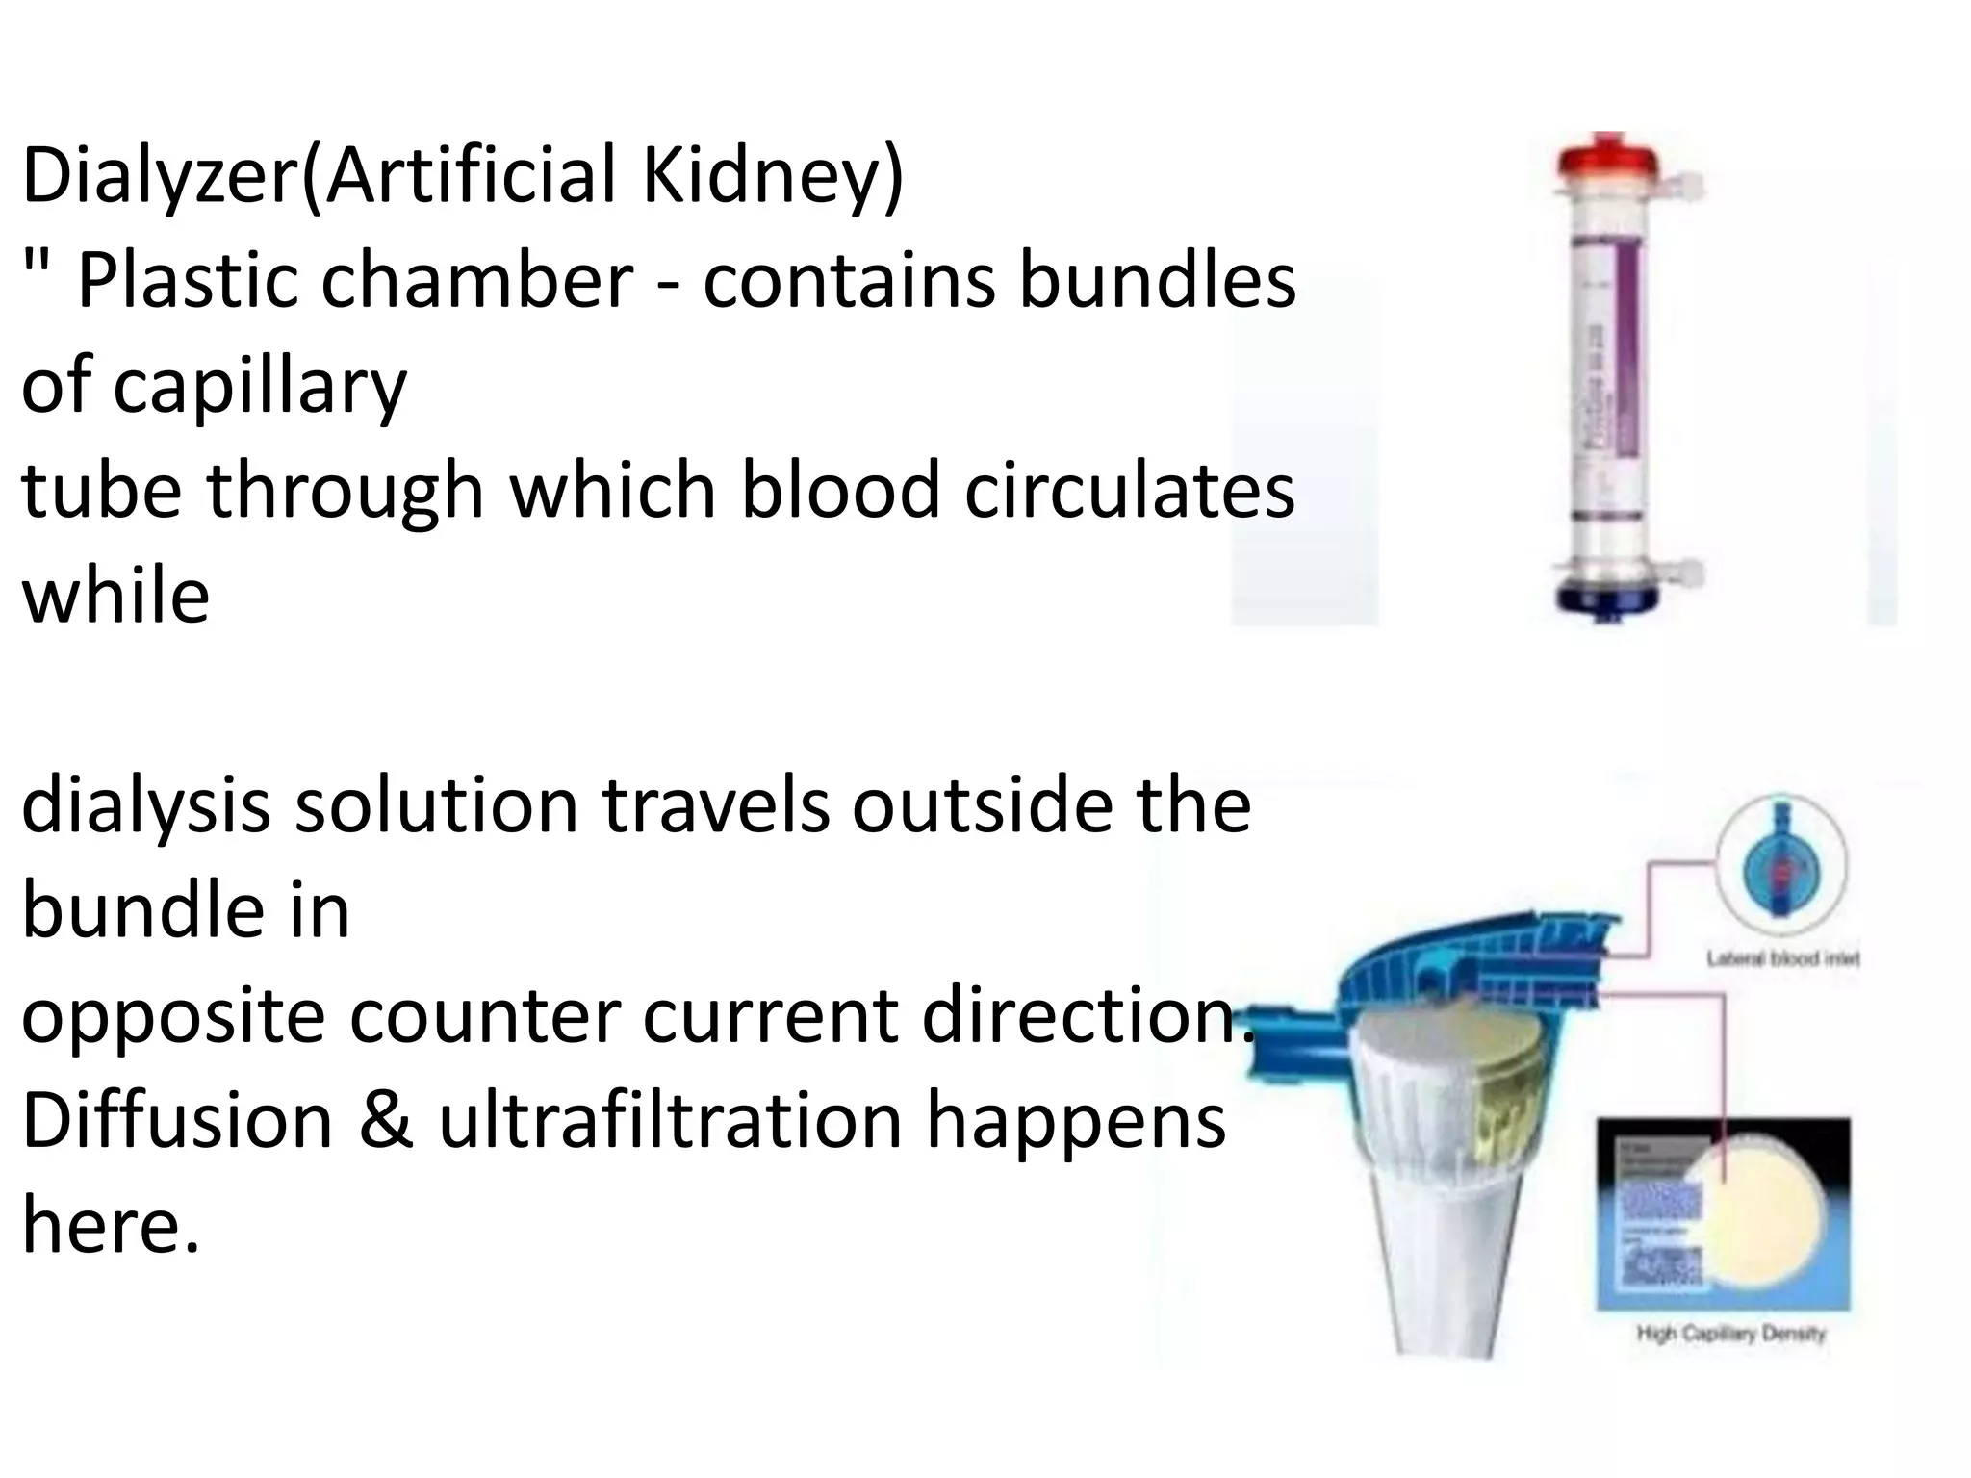

Slide 20
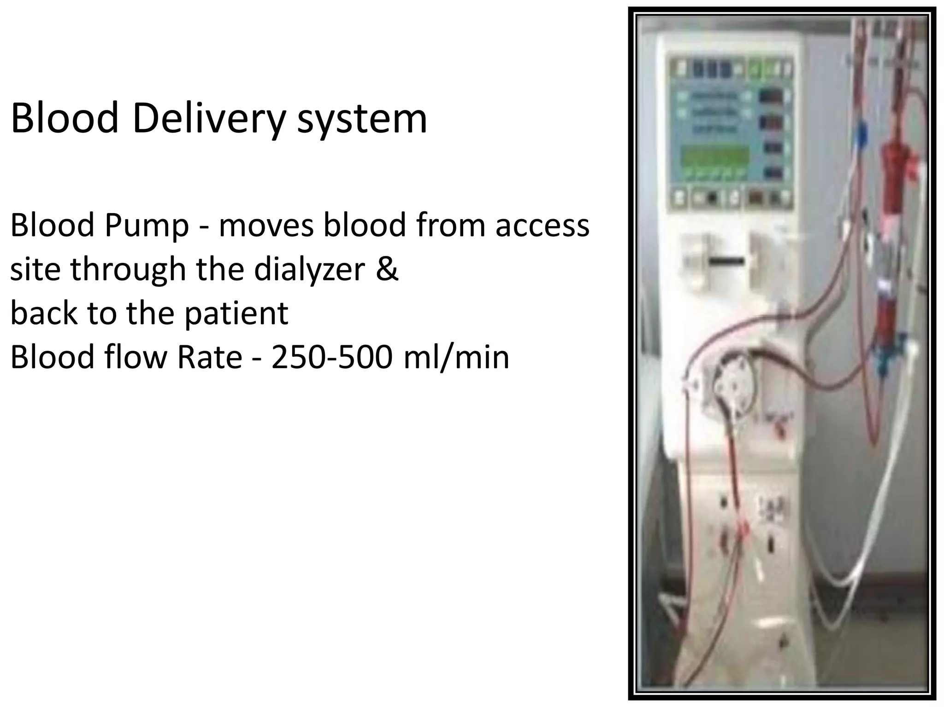

Slide 21
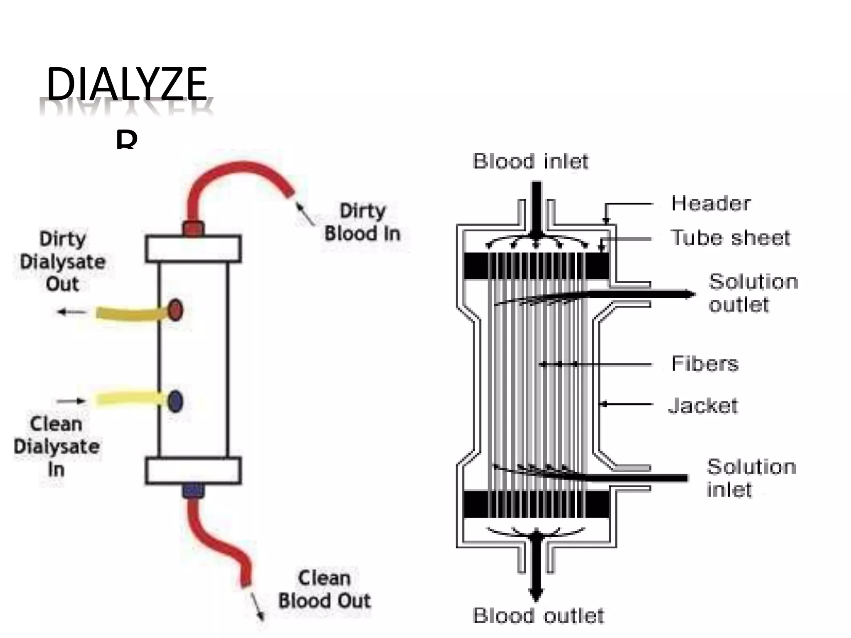

Slide 22
How dialysis machine works?
The basic principle of dialysis machine or artificial kidney is to pass blood through minute blood channels ( instead of blood vessels in machine) bounded by thin membrane.
On the other side of the membrane is a dialysis fluid into which unwanted substances in the blood pass by diffusion.
The dialysis machine pumps blood through the filter and returns the blood to the body.
Dialysis filter works like natural nephron in order to remove waste and excess of water from the blood.

Slide 23
During the process, the dialysis machine checks the blood pressure and controls rapid flow of blood flows through the filter and fluid is removed from the body
Blood enters at one end of the filter and is forced into many, very thin, hollow fibres.
As blood moves swiftly through the hollow fibre, dialysis solution passes in the opposite direction on the outside of the fibres.
Waste products from the blood move into the dialysis solution.

Slide 24
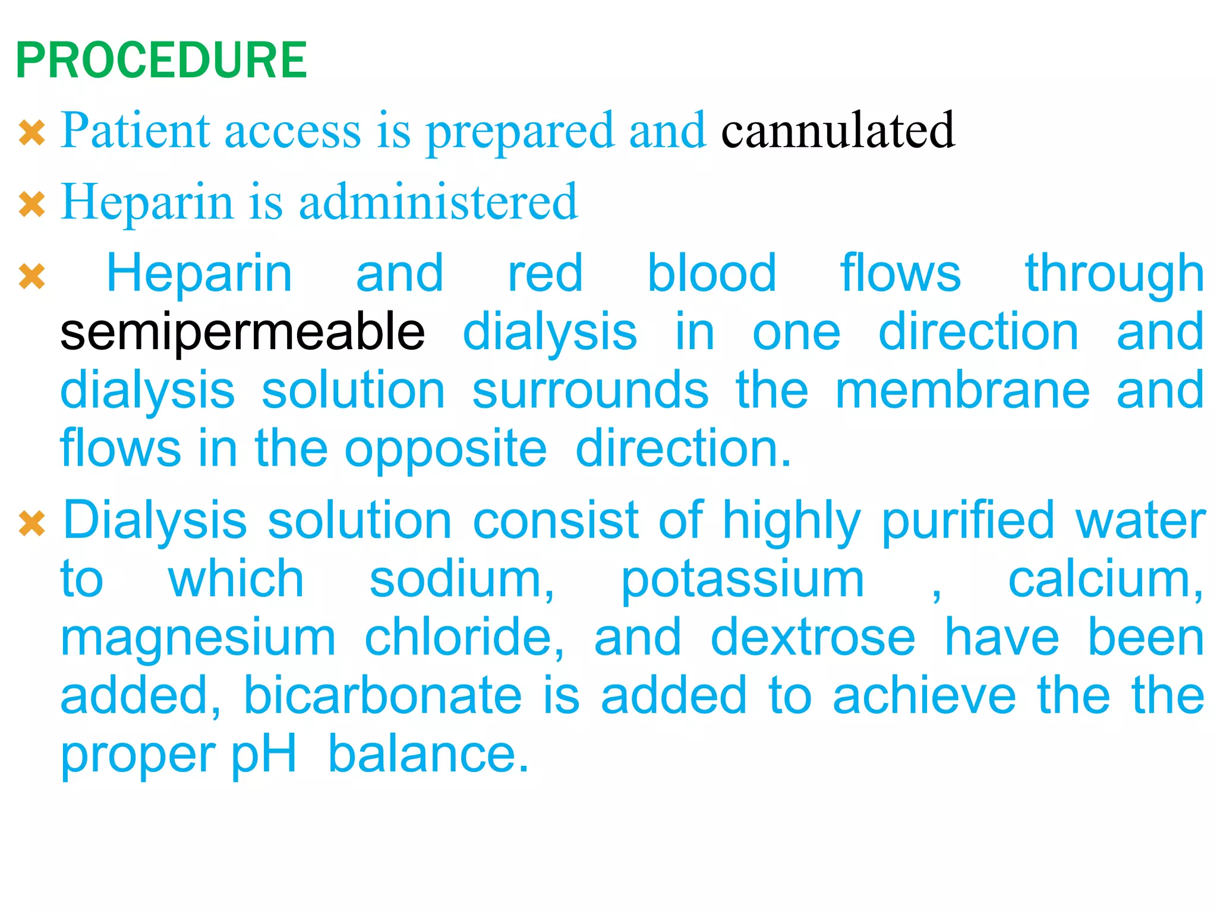
(Thin tube in to veins)

Slide 25
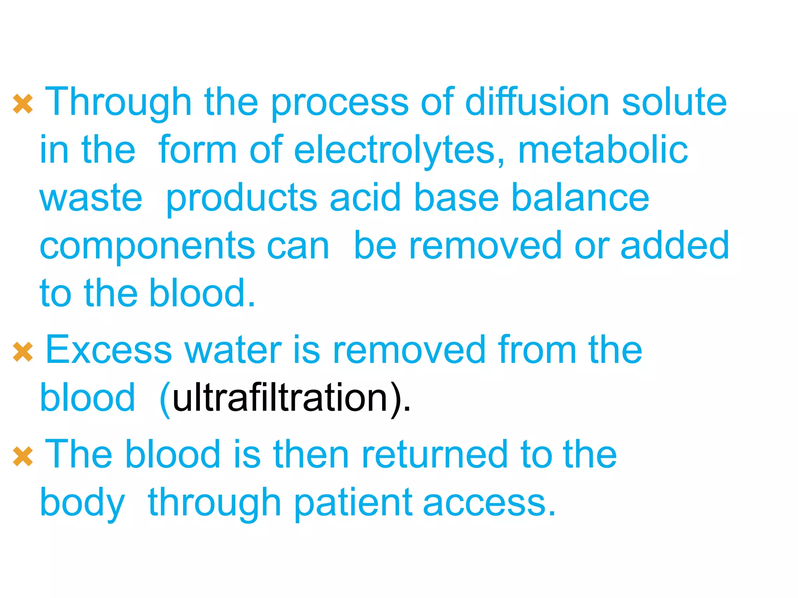

Slide 26
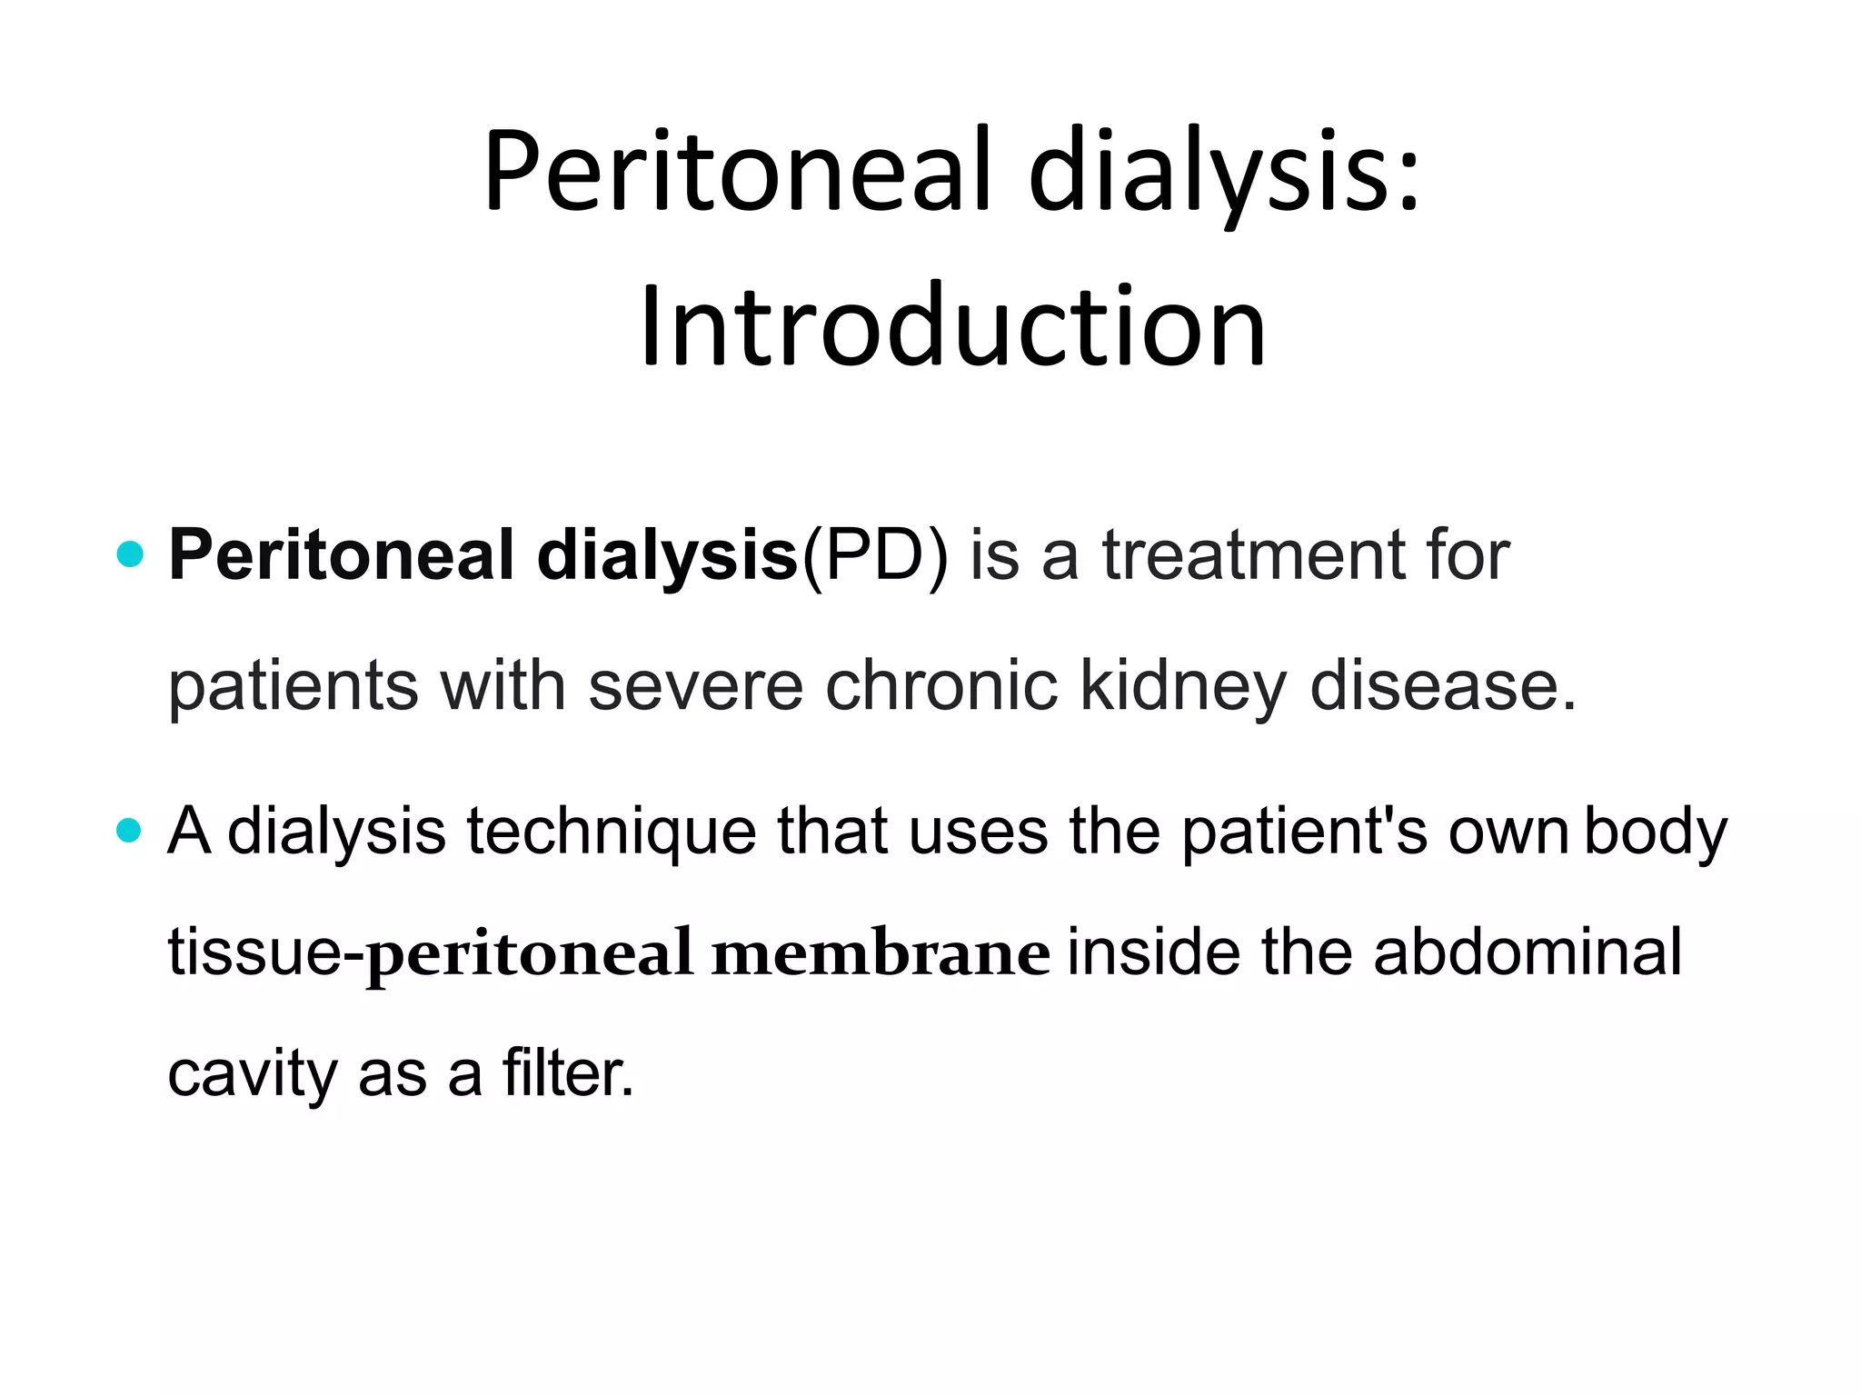

Slide 27
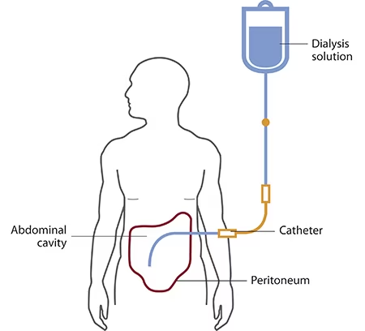
Peritoneal Dialysis

Slide 28
A few weeks before you start peritoneal dialysis, a surgeon places a soft tube, called a catheter, in your belly.
When start the treatment, dialysis solution—water with salt and other additives—flows from a bag through the catheter into your belly.
When the bag is empty, you disconnect it and place a cap on your catheter so you can move around and do your normal activities.
While the dialysis solution is inside your belly, it absorbs wastes and extra fluid from your body.

